Slide 1
Cross Wordle
A game by Matteo Salverio

Slide 2
The Prompt
In 2022, Wordle and similar word games were all the rage across the world. Develop a word game with rules and a theme of your choice.
The game should be an executable game, either through the Internet or through a local installation (review guidelines about Internet access at the National Leadership Conference).
The game should contain a scoreboard.
The game should contain a leaderboard and celebratory messages.
The game should have a minimum of three levels.
The game should have an instructional display.

Slide 3
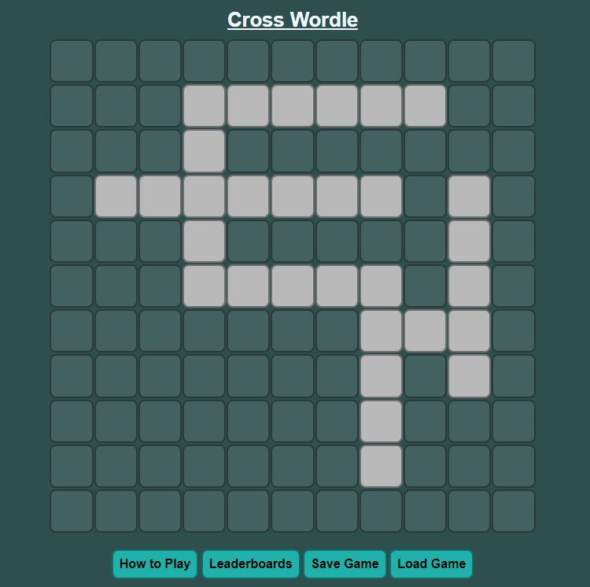
My Game
The game that I created is called Cross Wordle.
It is like Wordle but takes the gameplay to the second dimension with a full crossword-style puzzle connecting words and ideas, each being a puzzle of their own.

Slide 4
Planning and Design
I chose to make this game using JavaScript on an HTML page.
I wanted the game to play like a crossword puzzle, but for each word have it play like Wordle.
There were many design variations throughout making the game

Slide 5

Programming Language
I chose to make this game using JavaScript on an HTML page.
Can utilize HTML design features
Seamless communication between front and back-end

Slide 6
Gameplay
The game is played mostly like a crossword puzzle, but instead of hints for each word, the player uses previous guesses to find the word, like Wordle.

